Slide 1
Antrix Consultancy Services
Java Server Pages (JSP)
Basics

Slide 2
Antrix Consultancy Services
What do you mean by Static & Dynamic Contents?
●
Static contents
–
–
Typically static HTML page
Same display for everyone
●
Dynamic contents
–
–
Contents is dynamically generated based on conditions
Conditions could be
●
●
●
User identity
Time of the day
User entered values through forms and selections
–
Examples
●
Etrade webpage customized just for you, my Yahoo
Madhusudhanan.P.K.

Slide 3
Antrix Consultancy Services
What is JSP Page?
●
●
●
A text-based document capable of returning both static and dynamic
content to a client browser
Static content and dynamic content can be intermixed
Static content
–
HTML, XML, Text
●
Dynamic content
–
–
–
Java code
Displaying properties of JavaBeans
Invoking business logic defined in Custom tags
Madhusudhanan.P.K.

Slide 4
Antrix Consultancy Services
A Simple JSP Page
(Blue: static, Red: Dynamic contents)
<html>
<body>
Hello World!
<br>
Current time is <%= new java.util.Date() %>
</body>
</html>
Madhusudhanan.P.K.

Slide 5
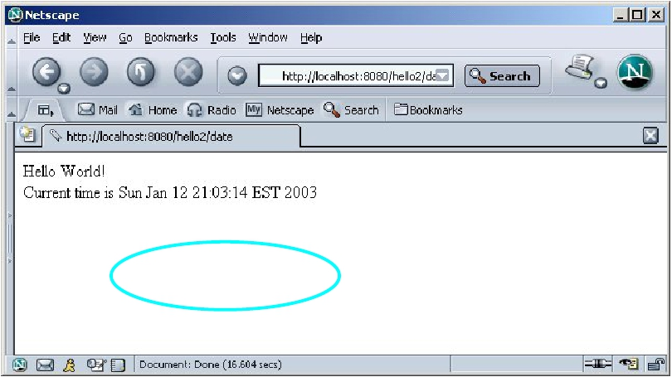
Antrix Consultancy Services
Output
Madhusudhanan.P.K.

Slide 6


Antrix Consultancy Services
JSP
Servlets
JSP
●
HTML code in
●
Java-like code in
Java
● Not easy to
author
HTML
● Very easy to author
● Code is compiled
into a servlet
Madhusudhanan.P.K.

Slide 7
Antrix Consultancy Services
JSP Benefits
●
●
●
●
●
●
Content and display logic are separated
Simplify web application development with JSP, JavaBeans and
custom tags
Supports software reuse through the use of components
(JavaBeans, Custom tags)
Recompile automatically when changes are made to JSP pages
Easier to author web pages
Platform-independent
Madhusudhanan.P.K.

Slide 8
Antrix Consultancy Services
Why JSP over Servlet?
●
●
Servlets can do a lot of things, but it is difficult to:
Use those println() statements to generate HTML page
Maintain that HTML page
No need for compiling, packaging,CLASSPATH setting
Madhusudhanan.P.K.

Slide 9
Antrix Consultancy Services
JSP over Servlet or vice-versa?
●
No, you want to use both leveraging the strengths of each technology
–
–
Servlet's strength is “controlling and dispatching”
JSP's strength is “displaying”
●
In a typically production environment, both servlet and JSP are used in
a so-called MVC (Model-View-Controller) pattern
–
–
Servlet handles controller part
JSP handles view part
Madhusudhanan.P.K.

Slide 10
Antrix Consultancy Services
JSP
Architecture
Madhusudhanan.P.K.

Slide 11
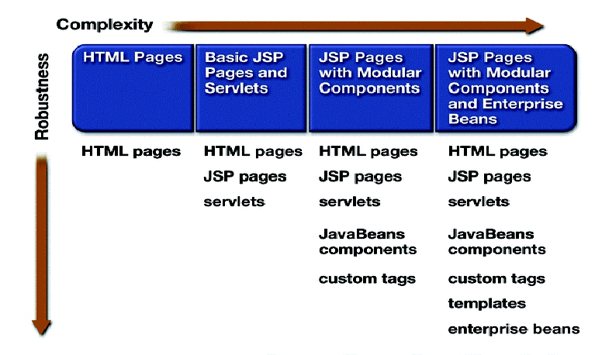
Antrix Consultancy Services
Web Application Designs
Madhusudhanan.P.K.

Slide 12
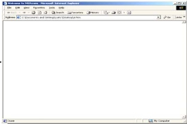
Antrix Consultancy Services
Separate Request processing From Presentation
Servlet
Public class OrderServlet…{
public void doGet(…){
……
Request processing
presentation
Business logic
if(bean.isOrderValid(..)){
bean.saveOrder(….);
forward(“conf.jsp”);
}
}
JSP
<html>
<body>
<ora: loop name =“order”>
…..
</ora:loop>
<body>
</html>
JavaBeans
isOrderValid( )
saveOrder( )
Pure Servlet
Public class OrderServlet…{
public void doGet(…){
if(isOrderValid(req)){
saveOrder(req);
out.println(“<html>”);
out.println(“<body>”);
……
private void isOrderValid(….){
……
}
private void saveOrder(….){
……
}
}
Madhusudhanan.P.K.

Slide 13
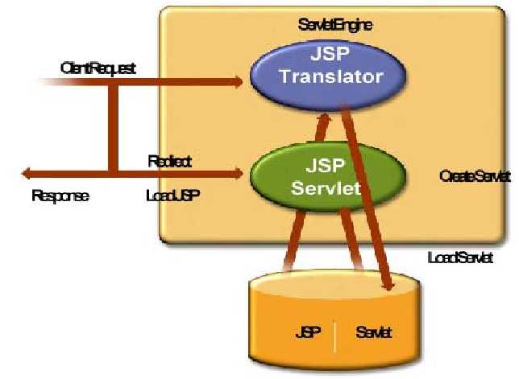
Antrix Consultancy Services
JSP Architecture
Madhusudhanan.P.K.

Slide 14
Antrix Consultancy Services
Life-Cycle of a JSP Page
Madhusudhanan.P.K.

Slide 15
Antrix Consultancy Services
How Does JSP Work?
User Request
Server
File
ChangedJSP
?
Create Source
Compile
Execute Servlet
Madhusudhanan.P.K.

Slide 16
Antrix Consultancy Services
JSP Page Lifecycle Phases
●
●
●
Translation phase
Compile phase
Execution phase
Madhusudhanan.P.K.

Slide 17
Antrix Consultancy Services
Translation/Compilation Phase
●
●
●
●
JSP files get translated into servlet source code, which is then compiled
Done by the container automatically
The first time JSP page is accessed after it is deployed (or modified and
redeployed)
For JSP page “pageName”, the source code resides
–
–
<JWSDP_HOME>/work/Standard Engine/localhost/context_root/pageName$jsp.java
<JWSDP_HOME>/work/Standard Engine/localhost/date/index$jsp.java
Madhusudhanan.P.K.

Slide 18
Antrix Consultancy Services
Translation/Compilation Phase
●
●
Static Template data is transformed into code that will emit data into the
stream
JSP elements are treated differently
–
–
–
Directives are used to control how Web container translates and executes JSP page
Scripting elements are inserted into JSP page's servlet class
Elements of the form <jsp:xxx .../> are converted into method calls to JavaBeans
components
Madhusudhanan.P.K.

Slide 19
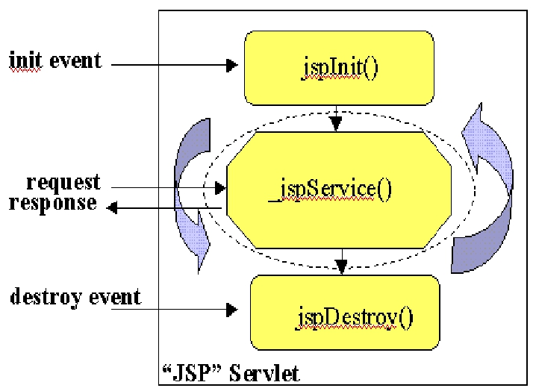
Antrix Consultancy Services
JSP Lifecycle Methods during Execution Phase
Madhusudhanan.P.K.

Slide 20
Antrix Consultancy Services
Initialization of a JSP Page
●
Declare methods for performing the following tasks using JSP declaration
mechanism
–
–
–
Read persistent configuration data
Initialize resources
Perform any other one-time activities by overriding jstInit() method of JspPage
interface
Madhusudhanan.P.K.

Slide 21
Antrix Consultancy Services
Finalization of a JSP Page
●
Declare methods for performing the following tasks using JSP declaration
mechanism
–
–
–
Read persistent configuration data
Release resources
Perform any other one-time cleanup activities by overriding jstDestroy() method of
JspPage interface
Madhusudhanan.P.K.

Slide 22
Antrix Consultancy Services
Example: initdestroy.jsp
<%@ page import="database.*" %>
<%@ page errorPage="errorpage.jsp" %>
<%-- Declare initialization and finalization methods using JSP declaration --%>
<%!
private BookDBAO bookDBAO;
public void jspInit() {
// retrieve database access object, which was set once per web application
bookDBAO =
(BookDBAO)getServletContext().getAttribute("bookDB");
if (bookDBAO == null)
System.out.println("Couldn't get database.");
}
public void jspDestroy() {
bookDBAO = null;
}
%>
Madhusudhanan.P.K.

Slide 23
Antrix Consultancy Services
Steps for Developing
JSP-based Web Application
Madhusudhanan.P.K.

Slide 24
Antrix Consultancy Services
Web Application Development
and Deployment Steps
1. Write (and compile) the Web component code (Servlet or JSP) and helper
classes referenced by the web component code
2. Create any any static resources (for example, images or HTML pages)
3. Create deployment descriptor (web.xml)
4. Build the Web application (*.war file or deployment-ready directory)
5. Install or deploy the web application into a Web container
●
Web clients are now ready to access them via URL
Madhusudhanan.P.K.

Slide 25
Antrix Consultancy Services
1. Write and compile the Web component code
●
●
●
Create development tree structure
Write either servlet code and/or JSP pages along with related helper code
Create build.xml for Ant-based build (and other application life-cycle
management) process
Madhusudhanan.P.K.

Slide 26
Antrix Consultancy Services
Dynamic Content Generation Techniques
in JSP
Madhusudhanan.P.K.

Slide 27
Antrix Consultancy Services
Dynamic Contents Generation Techniques with
JSP Technology
●
Various techniques can be chosen depending on the following factors
–
–
size and complexity of the project
Requirements on reusability of code, maintenability, degree of robustness
●
Simple to incrementally complex techniques are available
Madhusudhanan.P.K.

Slide 28
Antrix Consultancy Services
Dynamic Contents Generation Techniques with JSP
a) Call Java code directly within JSP
b) Call Java code indirectly within JSP
c) Use JavaBeans within JSP
d) Develop and use your own custom tags
e) Leverage 3rd-party custom tags or JSTL (JSP Standard Tag Library)
f) Follow MVC design pattern
g) Leverage Model2 frameworks
Madhusudhanan.P.K.

Slide 29
Antrix Consultancy Services
(a) Call Java code directly
●
●
Place all Java code in JSP page
Suitable only for a very simple Web application
–
–
–
hard to maintain
hard to reuse code
hard to understand for web page authors
●
Not recommended for relatively sophisticated Web applications
–
weak separation between contents and presentation
Madhusudhanan.P.K.

Slide 30
Antrix Consultancy Services
(b) Call Java code indirectly
●
●
●
●
●
Develop separate utility classes
Insert into JSP page only the Java code needed to invoke the utility classes
Better separation of contents generation from presentation logic than the
previous method
Better reusability and maintainability than the previous method
Still weak separation between contents and presentation
Madhusudhanan.P.K.

Slide 31
Antrix Consultancy Services
(c) Use JavaBeans
●
●
Develop utility classes in the form of JavaBeans
Leverage built-in JSP facility of creating JavaBeans instances, getting and
setting JavaBeans properties
–
Use JSP element syntax
●
●
Easier to use for web page authors
Better reusability and maintainability than the previous method
Madhusudhanan.P.K.

Slide 32
Antrix Consultancy Services
(d) Develop and Use Custom Tags
●
Develop sophisticated components called custom tags
–
Custom tags are specifically designed for JSP
●
●
More powerful than JavaBeans component
Reusability, maintainability, robustness
Madhusudhanan.P.K.

Slide 33
Antrix Consultancy Services
(e) Use 3rd-party Custom tags or
JSTL
●
There are many open source and commercial custom tags available
–
Apache Struts
●
JSTL (JSP Standard Tag Library) standardize the set of custom tags that
should be available over J2EE platform at a minimum
–
As a developer or deployer, you can be assured that a standard set of custom tags are
already present in J2EE compliant platform (J2EE 1.3 and after)
Madhusudhanan.P.K.

Slide 34
Antrix Consultancy Services
(f, g) Use MVC Design Pattern
●
●
Follow MVC design pattern
Or use open source or commercial Model2 frameworks
–
–
–
–
Apache Struts
JavaServer Faces
Sun ONE Application Framework
Other JavaServer Pages based implementations
Madhusudhanan.P.K.

Slide 35
Antrix Consultancy Services
Invoking Java Code
with JSP Scripting Elements
Madhusudhanan.P.K.

Slide 36
Antrix Consultancy Services
JSP Scripting Elements
●
●
●
Lets you insert Java code into the servlet that will be generated from JSP page
Minimize the usage of JSP scripting elements in your JSP pages if possible
There are three forms
–
–
–
Expressions: <%= Expressions %>
Scriptlets: <% Code %>
Declarations: <%! Declarations %>
Madhusudhanan.P.K.

Slide 37
Antrix Consultancy Services
Expressions
●
During execution phase
–
–
–
–
Expression is evaluated and converted into a String
The String is then Inserted into the servlet's output stream directly
Results in something like out.println(expression)
Can use predefined variables (implicit objects) within expression
●
Format
<%= Expression %> or
<jsp:expression>Expression</jsp:expression>
Semi-colons are not allowed for expressions
Madhusudhanan.P.K.

Slide 38
Antrix Consultancy Services
Example: Expressions
●
Display current time using Date class
–
Current time: <%= new java.util.Date() %>
●
Display random number using Math class
–
Random number: <%= Math.random() %>
●
Use implicit objects
–
–
–
–
Your hostname: <%= request.getRemoteHost() %>
Your parameter: <%= request. getParameter(“yourParameter”) %>
Server: <%= application.getServerInfo() %>
Session ID: <%= session.getId() %>
Madhusudhanan.P.K.

Slide 39
Antrix Consultancy Services
Scriptlets
●
●
Used to insert arbitrary Java code into servlet's jspService() method
Can do things expressions alone cannot do
–
–
–
–
setting response headers and status codes
writing to a server log
updating database
executing code that contains loops, conditionals
●
●
Can use predefined variables (implicit objects)
Format:
–
–
<% Java code %> or
<jsp:scriptlet> Java code</jsp:scriptlet>
Madhusudhanan.P.K.

Slide 40
Antrix Consultancy Services
Example: Scriptlets
●
●
Display query string
<%
String queryData = request.getQueryString();
out.println(“Attached GET data: “ + queryData);
%>
Settng response type
<% response.setContentType(“text/plain”); %>
Madhusudhanan.P.K.

Slide 41
Antrix Consultancy Services
Example: Scriptlet with Loop
<%
Iterator i = cart.getItems().iterator();
while (i.hasNext()) {
ShoppingCartItem item =
(ShoppingCartItem)i.next();
BookDetails bd = (BookDetails)item.getItem();
%>
<tr>
<td align="right" bgcolor="#ffffff">
<%=item.getQuantity()%>
</td>
<td bgcolor="#ffffaa">
<strong><a href="
<%=request.getContextPath()%>/bookdetails?bookId=
<%=bd.getBookId()%>"><%=bd.getTitle()%></a></strong>
</td>
...
<%
// End of while
}
%>
Madhusudhanan.P.K.

Slide 42
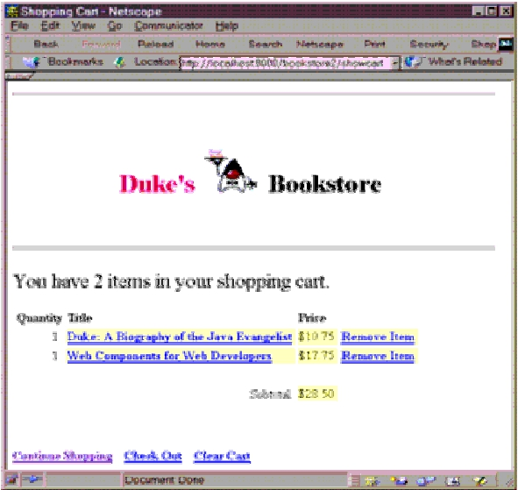
Antrix Consultancy Services
Example: Scriptlet Result
Madhusudhanan.P.K.

Slide 43
Antrix Consultancy Services
Example: JSP page fragment
●
Suppose we have the following JSP page fragment
–
–
–
<H2> sangHTML </H2>
<%= sangExpression() %>
<% sangScriptletCode(); %>
Madhusudhanan.P.K.

Slide 44
Antrix Consultancy Services
Example: Resulting Servlet Code
public void _jspService(HttpServletRequest request,
HttpServletResponse response)
throws ServletException, IOException {
response.setContentType(“text/html”);
HttpSession session = request.getSession(true);
JSPWriter out = response.getWriter();
// Static HTML fragment is sent to output stream in “as is” form
out.println(“<H2>sangHTML</H2>”);
// Expression is converted into String and then sent to output
out.println(sangExpression());
// Scriptlet is inserted as Java code within _jspService()
sangScriptletCode();
...
}
Madhusudhanan.P.K.

Slide 45
Antrix Consultancy Services
Declarations
●
Used to define variables or methods that get inserted into the main body of
servlet class
–
–
Outside of _jspSevice() method
Implicit objects are not accessible to declarations
●
●
●
Usually used with Expressions or Scriptlets
For initialization and cleanup in JSP pages, use declarations to override jspInit()
and jspDestroy() methods
Format:
–
–
<%! method or variable declaration code %>
<jsp:declaration> method or variable declaration code </jsp:declaration>
Madhusudhanan.P.K.

Slide 46
Antrix Consultancy Services
Example: JSP Page fragment
<H1>Some heading</H1>
<%!
private String randomHeading() {
return(“<H2>” + Math.random() + “</H2>”);
}
%>
<%= randomHeading() %>
Madhusudhanan.P.K.

Slide 47
Antrix Consultancy Services
Example: Resulting Servlet Code
public class xxxx implements HttpJSPPage {
private String randomHeading() {
return(“<H2>” + Math.random() + “</H2>”);
}
public void _jspService(HttpServletRequest request,
HttpServletResponse response)
throws ServletException, IOException {
response.setContentType(“text/html”);
HttpSession session = request.getSession(true);
JSPWriter out = response.getWriter();
out.println(“<H1>Some heading</H1>”);
out.println(randomHeading());
...
}
...
}
Madhusudhanan.P.K.

Slide 48
Antrix Consultancy Services
Example: Declaration
<%!
private BookDBAO bookDBAO;
public void jspInit() {
...
}
public void jspDestroy() {
...
}
%>
Madhusudhanan.P.K.

Slide 49
Antrix Consultancy Services
Why XML Syntax?
●
●
From JSP 1.2
Examples
–
–
–
<jsp:expression>Expression</jsp:expression>
<jsp:scriptlet> Java code</jsp:scriptlet>
<jsp:declaration> declaration code </jsp:declaration>
●
You can leverage
–
–
XML validation (via XML schema)
Many other XML tools
●
●
●
editor
transformer
Java APIs
Madhusudhanan.P.K.

Slide 50
Antrix Consultancy Services
Including and Forwarding to
Other Web Resource
Madhusudhanan.P.K.

Slide 51
Antrix Consultancy Services
Including Contents in a JSP Page
●
Two mechanisms for including another Web resource in a JSP page
–
–
include directive
jsp:include element
Madhusudhanan.P.K.

Slide 52
Antrix Consultancy Services
Include Directive
●
●
●
●
Is processed when the JSP page is translated into a servlet class
Effect of the directive is to insert the text contained in another file-- either
static content or another JSP page--in the including JSP page
Used to include banner content, copyright information, or any chunk of content
that you might want to reuse in another page
Syntax and Example
–
–
<%@ include file="filename" %>
<%@ include file="banner.jsp" %>
Madhusudhanan.P.K.

Slide 53
Antrix Consultancy Services
jsp:include Element
●
●
Is processed when a JSP page is executed
Allows you to include either a static or dynamic resource in a JSP file
–
–
static: its content is inserted into the calling JSP file
dynamic: the request is sent to the included resource, the included page is executed, and
then the result is included in the response from the calling JSP page
●
Syntax and example
–
–
<jsp:include page="includedPage" />
<jsp:include page="date.jsp"/>
Madhusudhanan.P.K.

Slide 54
Antrix Consultancy Services
Which One to Use it?
●
Use include directive if the file changes rarely
–
It is faster than jsp:include
●
●
Use jsp:include for content that changes often
Use jsp:include if which page to include cannot be decided until the main page
is requested
Madhusudhanan.P.K.

Slide 55
Antrix Consultancy Services
Forwarding to another Web component
●
●
Same mechanism as in Servlet
Syntax
–
<jsp:forward page="/main.jsp" />
●
Original request object is provided to the target page via jsp:parameter element
<jsp:include page="..." >
<jsp:param name="param1" value="value1"/>
</jsp:include>
Madhusudhanan.P.K.

Slide 56
Antrix Consultancy Services
Directives
Madhusudhanan.P.K.

Slide 57
Antrix Consultancy Services
Directives
●
●
●
Directives are messages to the JSP container in order to affect overall
structure of the servlet
Do not produce output into the current output stream
Syntax
<%@ directive {attr=value}* %>
Madhusudhanan.P.K.

Slide 58
Antrix Consultancy Services
Three Types of Directives
●
●
●
page: Communicate page dependent attributes and communicate these
to the JSP container
<%@ page import="java.util.* %>
include: Used to include text and/or code at JSP page translation-time
<%@ include file="header.html" %>
Taglib: Indicates a tag library that the JSP container should interpret
<%@ taglib uri="mytags" prefix="codecamp" %>
Madhusudhanan.P.K.

Slide 59
Antrix Consultancy Services
Page Directives
●
●
Give high-level information about the servlet that results from the
JSP page.
Control
Which classes are improted
•
<%@ page import="java.util.* %>
What MIME type is generated
•
<%@ page contentType="MIME-Type" %>
How multithreading is handled
•
•
<%@ page isThreadSafe="true" %> <%!--Default --%>
<%@ page isThreadSafe="false" %>
What page handles unexpected errors
•
<%@ page errorPage="errorpage.jsp" %>
Madhusudhanan.P.K.

Slide 60
Antrix Consultancy Services
Implicit Objects
●
●
●
A JSP page has access to certain implicit objects that are always
available, without being declared first
Created by container
Corresponds to classes defined in Servlet
Madhusudhanan.P.K.

Slide 61
Antrix Consultancy Services
Implicit Objects
●
●
●
●
●
●
●
request (HttpServletRequest)
response (HttpServletRepsonse)
session (HttpSession)
application(ServletContext)
out (of type JspWriter)
config (ServletConfig)
pageContext
Madhusudhanan.P.K.

Slide 62
Antrix Consultancy Services
Scope Objects
Madhusudhanan.P.K.

Slide 63
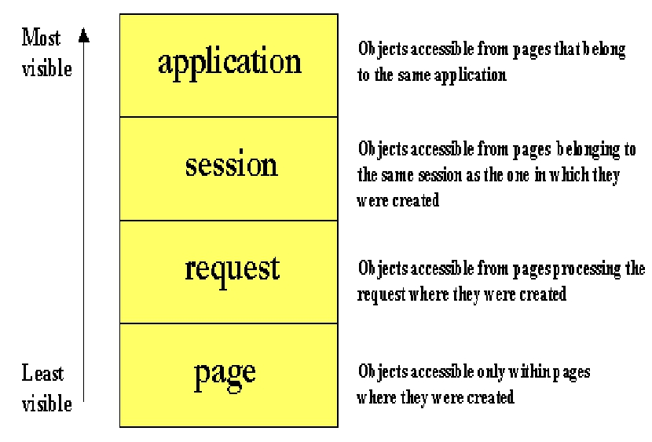
Antrix Consultancy Services
Different Scope
Madhusudhanan.P.K.

Slide 64





Antrix Consultancy Services
Session, Application Scope
Client 1
Session 1
Session ID 1
server
Client 2
Session ID 2
Session 2
Client 1
server
application
Client 2
Madhusudhanan.P.K.

Slide 65









Antrix Consultancy Services
Session, Request, Page Scope
client
request
response
request
response
Page 1
forward
Page 2
Page 3
forward
Page 4
Page scope
Page scope
Page scope
Page scope
request scope
request scope
Madhusudhanan.P.K.
Sessio scope

Slide 66
Antrix Consultancy Services
JavaBeans Components
for JSP
Madhusudhanan.P.K.

Slide 67
Antrix Consultancy Services
What are JavaBeans?
●
●
Java classes that can be easily reused and composed together into an
application
Any Java class that follows certain design conventions can be a
JavaBeans component
–
–
properties of the class
public methods to get and set properties
●
●
Within a JSP page, you can create and initialize beans and get and set
the values of their properties.
JavaBeans can contain business logic or data base access logic.
Madhusudhanan.P.K.

Slide 68
Antrix Consultancy Services
JavaBeans Design Conventions
●
●
JavaBeans maintain internal properties
A property can be
–
–
Read/write, read-only, or write-only
Simple or indexed
●
Properties should be accessed and set via getXxx and setXxx methods
–
–
PropertyClass getProperty() { ... }
PropertyClass getProperty() { ... }
●
JavaBeans must have a zero-argument (empty) constructor
Madhusudhanan.P.K.

Slide 69
Antrix Consultancy Services
Example: JavaBeans
public class Currency {
private Locale locale;
private double amount;
public Currency() {
locale = null;
amount = 0.0;
}
public void setLocale(Locale l) {
locale = l;
}
public void setAmount(double a) {
amount = a;
}
public String getFormat() {
NumberFormat nf =
NumberFormat.getCurrencyInstance(locale);
return nf.format(amount);
}
}
Madhusudhanan.P.K.

Slide 70
Antrix Consultancy Services
Why Use JavaBeans in JSP Page?
●
A JSP page can create and use any type of Java programming
language object within a declaration or scriptlet like following:
<%
ShoppingCart cart = (ShoppingCart)session.getAttribute("cart");
// If the user has no cart, create a new one
if (cart == null) {
cart = new ShoppingCart();
session.setAttribute("cart", cart);
}
%>
Madhusudhanan.P.K.

Slide 71
Antrix Consultancy Services
Why Use JavaBeans in JSP Page?
●
JSP pages can use JSP elements to create and access the object that
conforms to JavaBeans conventions
●
<jsp:useBean id="cart" class="cart.ShoppingCart"
scope="session"/>
●
Create an instance of “ShoppingCart” if none exists, stores it as an
attribute of the session scope object, and makes the bean available
throughout the session by the identifier “cart”
Madhusudhanan.P.K.

Slide 72
Antrix Consultancy Services
Compare the Two
<%
ShoppingCart cart = (ShoppingCart)session.getAttribute("cart");
// If the user has no cart object as an attribute in Session scope
// object, then create a new one. Otherwise, use the existing
// instance.
if (cart == null) {
cart = new ShoppingCart();
session.setAttribute("cart", cart);
}
%>
versus
<jsp:useBean id="cart" class="cart.ShoppingCart"
scope="session"/>
Madhusudhanan.P.K.

Slide 73
Antrix Consultancy Services
Why Use JavaBeans in JSP Page?
●
●
●
●
●
No need to learn Java programming language for page designers
Stronger separation between content and presentation
Higher reusability of code
Simpler object sharing through built-in sharing mechanism
Convenient matching between request parameters and object properties
Madhusudhanan.P.K.

Slide 74
Antrix Consultancy Services
Creating a JavaBeans
●
Declare that the page will use a bean that is stored within and accessible
from the specified scope by jsp:useBean element
<jsp:useBean id="beanName" class="fully_qualified_classname" scope="scope"/>
or
<jsp:useBean id="beanName" class="fully_qualified_classname" scope="scope">
<jsp:setProperty .../>
</jsp:useBean>
Madhusudhanan.P.K.

Slide 75
Antrix Consultancy Services
Setting JavaBeans Properties
●
●
2 ways to set a property of a bean
Via scriptlet
–
<% beanName.setPropName(value); %>
●
Via JSP:setProperty
–
–
–
<jsp:setProperty name="beanName" property="propName" value="string constant"/>
“beanName” must be the same as that specified for the id attribute in a useBean element
There must be a setPropName method in the bean
Madhusudhanan.P.K.

Slide 76
Antrix Consultancy Services
Setting JavaBeans Properties
●
jsp:setProperty syntax depends on the source of the property
–
–
–
–
–
<jsp:setProperty name="beanName" property="propName" value="string constant"/>
<jsp:setProperty name="beanName" property="propName" param="paramName"/>
<jsp:setProperty name="beanName" property="propName"/>
<jsp:setProperty name="beanName" property="*"/>
<jsp:setProperty name="beanName" property="propName" value="<%= expression
%>"/>
Madhusudhanan.P.K.

Slide 77
Antrix Consultancy Services
Example: jsp:setProperty with Request parameter
<jsp:setProperty name="bookDB" property="bookId"/>
is same as
<%
//Get the identifier of the book to display
String bookId = request.getParameter("bookId");
bookDB.setBookId(bookId);
...
%>
Madhusudhanan.P.K.

Slide 78
Antrix Consultancy Services
Example: jsp:setProperty with Expression
<jsp:useBean id="currency" class="util.Currency" scope="session">
<jsp:setProperty name="currency" property="locale"
value="<%= request.getLocale() %>"/>
</jsp:useBean>
<jsp:setProperty name="currency" property="amount"
value="<%=cart.getTotal()%>"/>
Madhusudhanan.P.K.

Slide 79
Antrix Consultancy Services
Getting JavaBeans Properties
●
2 different ways to get a property of a bean
–
–
Convert the value of the property into a String and insert the value into the current
implicit “out” object
Retrieve the value of a property without converting it to a String and inserting it into the
“out” object
Madhusudhanan.P.K.

Slide 80
Antrix Consultancy Services
Getting JavaBeans Properties & and
Convert into String and insert into out
●
2 ways
–
via scriptlet
●
<%= beanName.getPropName() %>
–
via JSP:setProperty
●
<jsp:getProperty name="beanName" property="propName"/>
●
Requirements
–
–
“beanName” must be the same as that specified for the id attribute in a
useBean element
There must be a “getPropName()” method in a bean
Madhusudhanan.P.K.

Slide 81
Antrix Consultancy Services
Getting JavaBeans Properties without Converting it to
String
●
●
●
Must use a scriptlet
Format
<% Object o = beanName.getPropName(); %>
Example
<%
// Print a summary of the shopping cart
int num = cart.getNumberOfItems();
if (num > 0) {
%>
Madhusudhanan.P.K.

Slide 82

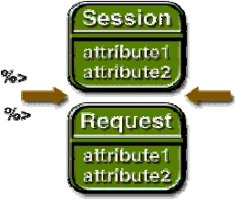
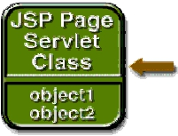




Antrix Consultancy Services
Accessing Objects from JSP Page
Madhusudhanan.P.K.

Slide 83
Antrix Consultancy Services
Error Handling
Madhusudhanan.P.K.

Slide 84
Antrix Consultancy Services
Creating An Exception Error Page
●
●
●
●
Determine the exception thrown
In each of your JSP, include the name of the error page
<%@ page errorPage="errorpage.jsp" %>
Develop an error page, it should include
<%@ page isErrorPage="true" %>
In the error page, use the exception reference to display exception
information
<%= exception.toString() %>
Madhusudhanan.P.K.

Slide 85
Antrix Consultancy Services
Example: initdestroy.jsp
<%@ page import="database.*" %>
<%@ page errorPage="errorpage.jsp" %>
<%!
private BookDBAO bookDBAO;
public void jspInit() {
// retrieve database access object, which was set once per web application
bookDBAO =
(BookDBAO)getServletContext().getAttribute("bookDB");
if (bookDBAO == null)
System.out.println("Couldn't get database.");
}
public void jspDestroy() {
bookDBAO = null;
}
%>
Madhusudhanan.P.K.

Slide 86
Antrix Consultancy Services
Example: errorpage.jsp
<%@ page isErrorPage="true" %>
<%@ page import="java.util.*" %>
<%
ResourceBundle messages = (ResourceBundle)session.getAttribute("messages");
if (messages == null) {
Locale locale=null;
String language = request.getParameter("language");
if (language != null) {
if (language.equals("English")) {
locale=new Locale("en", "");
} else {
locale=new Locale("es", "");
}
} else
locale=new Locale("en", "");
messages = ResourceBundle.getBundle("BookStoreMessages", locale);
session.setAttribute("messages", messages);
}
%> ...
Madhusudhanan.P.K.

Slide 87
Antrix Consultancy Services
Example: errorpage.jsp
... (continued)
<html>
<head>
<title><%=messages.getString("ServerError")%></title>
</head>
<body bgcolor="white">
<h3>
<%=messages.getString("ServerError")%>
</h3>
<p>
<%= exception.getMessage() %>
</body>
</html>
Madhusudhanan.P.K.

Slide 88
Antrix Consultancy Services
Date Example
Madhusudhanan.P.K.

Slide 89
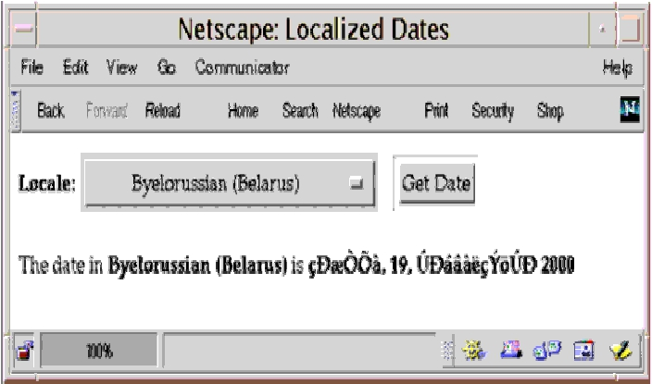
Antrix Consultancy Services
Date Example Output
Madhusudhanan.P.K.

Slide 90
Antrix Consultancy Services
Date Example
<%@ page import="java.util.*" %>
<%@ page import="MyLocales" %>
<%@ page contentType="text/html; charset=ISO-8859-5" %>
<html>
<head><title>Localized Dates</title></head>
<body bgcolor="white">
<jsp:useBean id="locales" scope="application" class="MyLocales"/>
<form name="localeForm" action="index.jsp" method="post">
<b>Locale:</b>
Madhusudhanan.P.K.

Slide 91
Antrix Consultancy Services
Date Example
<select name=locale>
<%
Iterator i = locales.getLocaleNames().iterator();
String selectedLocale = request.getParameter("locale");
while (i.hasNext()) {
String locale = (String)i.next();
if (selectedLocale != null && selectedLocale.equals(locale) ) { %>
<option selected><%=locale%></option>
<%
} else { %>
<option><%=locale%></option>
<% }
}
%>
</select>
<input type="submit" name="Submit" value="Get Date">
</form>
Madhusudhanan.P.K.

Slide 92
Antrix Consultancy Services
Date Example
<p>
<jsp:include page="date.jsp" flush="true" />
</body>
</html>
Madhusudhanan.P.K.

